Slide 1
CEGE0096: Geospatial Programming
Lecture 6: Geospatial Modelling
Dr. Aldo Lipani

Slide 2
Geospatial Modelling

Slide 3
Definition of GIS
“A Geographic Information System is a computer-based information system that enables capture, modelling, storage, retrieval, sharing, manipulation, analysis and presentation of geographically referenced data.”
Worboys and Duckham, 2004
In order to store, share, manipulate, analyze and present we first need to capture and model.
Capturing and modelling is dependent on our view of reality.

Slide 4
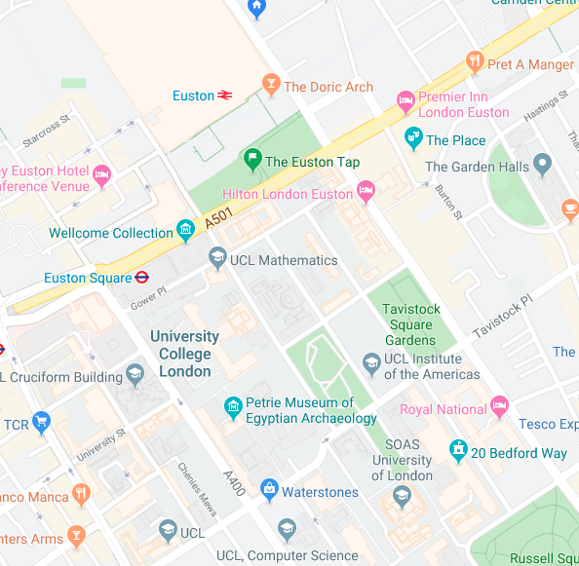
How do we Represent Reality?
On a piece of paper, draw three separate maps of:
Gower Street and its potholes;
The path to get from Euston Station to Chadwick Building;
Gower Street in a map of the UK.

Slide 5
How do we Represent Reality?
Each map demands a different way of representing Gower Street.
Each representation has advantages and disadvantages.
The representation is a simplification of the real-world feature.
Choosing the correct representation is an important decision.

Slide 6
Real vs. Digitally Represented Worlds
The real world:
Digitally represented world:
No straight lines
No hard edges
3D + Time
Ambiguous
Missing information
Unusual unexpected features
Locations can be a function of probability
Simplified geometry
2D (paper)
2D + Time (screen)
3D + Time (VR)
Specified time
Locations may not be precise
Locations may not be accurate

Slide 7
Accuracy vs. Precision
Accuracy is the closeness of a measured value to a standard or known value.
E.g. if you measure 3.2 meters but the actual or known distance is 10 meters:
Your measurement is not accurate.
It is not close to the known value.
Precision is the closeness of two or more measurements to each other.
Precision is independent of accuracy.
E.g. if you measure a distance five times, and each time you measure 3.2 meters, then your measurement is precise. Even if the distance is actually 10 meters.

Slide 8
Accuracy vs. Precision

Slide 9
Modelling
“A model is an artificial construction in which parts of one domain, termed the source domain, are represented in another domain, termed the target domain.”
Worboys and Duckham, 2004
A model is a simplification and an abstraction away from the source domain.
“All models are wrong, but some are useful.”
George E. P. Box
Examples include: paper and online maps, flight simulators, health models like hospital planning, meteorological models like weather forecasting, and geological models.

Slide 10
Fidelity vs Implementability
The usefulness of a model is trade-off between fidelity and implementability.
Fidelity is the degree to which the model represents the world;
Implementability is the degree to which the model can be used for storage, analysis, etc.

Slide 11
The Modelling Process – Waterfall Model
Application Domain
1
Application Domain Model
2
initial
study
Conceptual
Model
Computational Models
3
system
analysis
Logical Model
4
system
design
Physical
Model
system
implementation
5

Slide 12
Application Domain
1
The real world is referred to as the Application domain.
Observe the real world.
Everything happens in the context of the real world.

Slide 13
Application Domain Model
2
Focus only on the parts of the real world that are import to your world.
It is important to identify what is important and what is not.
At this stage you would produce a document with descriptive notes, diagrams, tables, etc.

Slide 14
Conceptual Model
3
What will the system do?
Identify phenomena, their attributes and their relationships to the world.
The real world phenomena can be conceptualized as either:
Continuous fields
Discrete features

Slide 15
Continuous Fields
A continuous field has a characteristic that is spatially continuous.
Values do not suddenly change at boundaries:
Temperature
NO₂ concentration

Slide 16
Discrete Features
A discrete feature (aka entity or object) is distinct from its environment and its neighbors due to an identifiable characteristic:
Building
Tree
Country
A post code
Discrete features can be classified.
Discrete features can be aggregated.

Slide 17
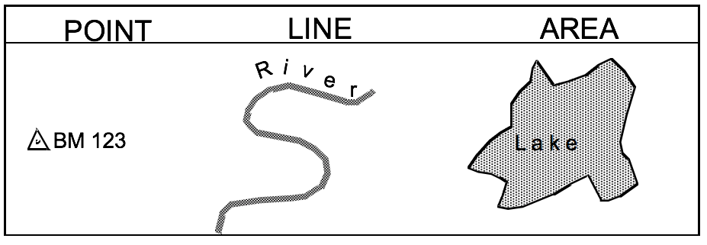
Dimensionality
Features can be conceptually modelled as:
0D entities i.e. Points;
1D entities i.e. Lines;
2D entities i.e. Areas, Surfaces;
3D entities i.e. Volumes, Solids.
Modelled either in 2D or 3D, e.g. a point in 3D space or a point on a 2D surface.
Features can be modelled in time.

Slide 18
Logical Model
4
How will the system implement the conceptual computational model?
Identify how phenomena might be represented in an information system.
What datatypes would be best to represent attributes?
E.g. How to represent colors?
“red” -- string
integer
#FF0000 -- hexadecimal integer representing RGB
(1.0, 0, 0) – floating point RGB tuple

Slide 19
Spatial Representations
Identify how the geometry of features and fields can be represented in the information system:
Vector representation;
Raster representation.

Slide 20
Vector Representation
A vector is a line segment (edge, wire) defined by its end points (vertices).
Line segments may be curved.
Requires less storage than raster for same fidelity.
A 0D geometric entity
A 1D geometric entity.
A 2D geometric entity.

Slide 21
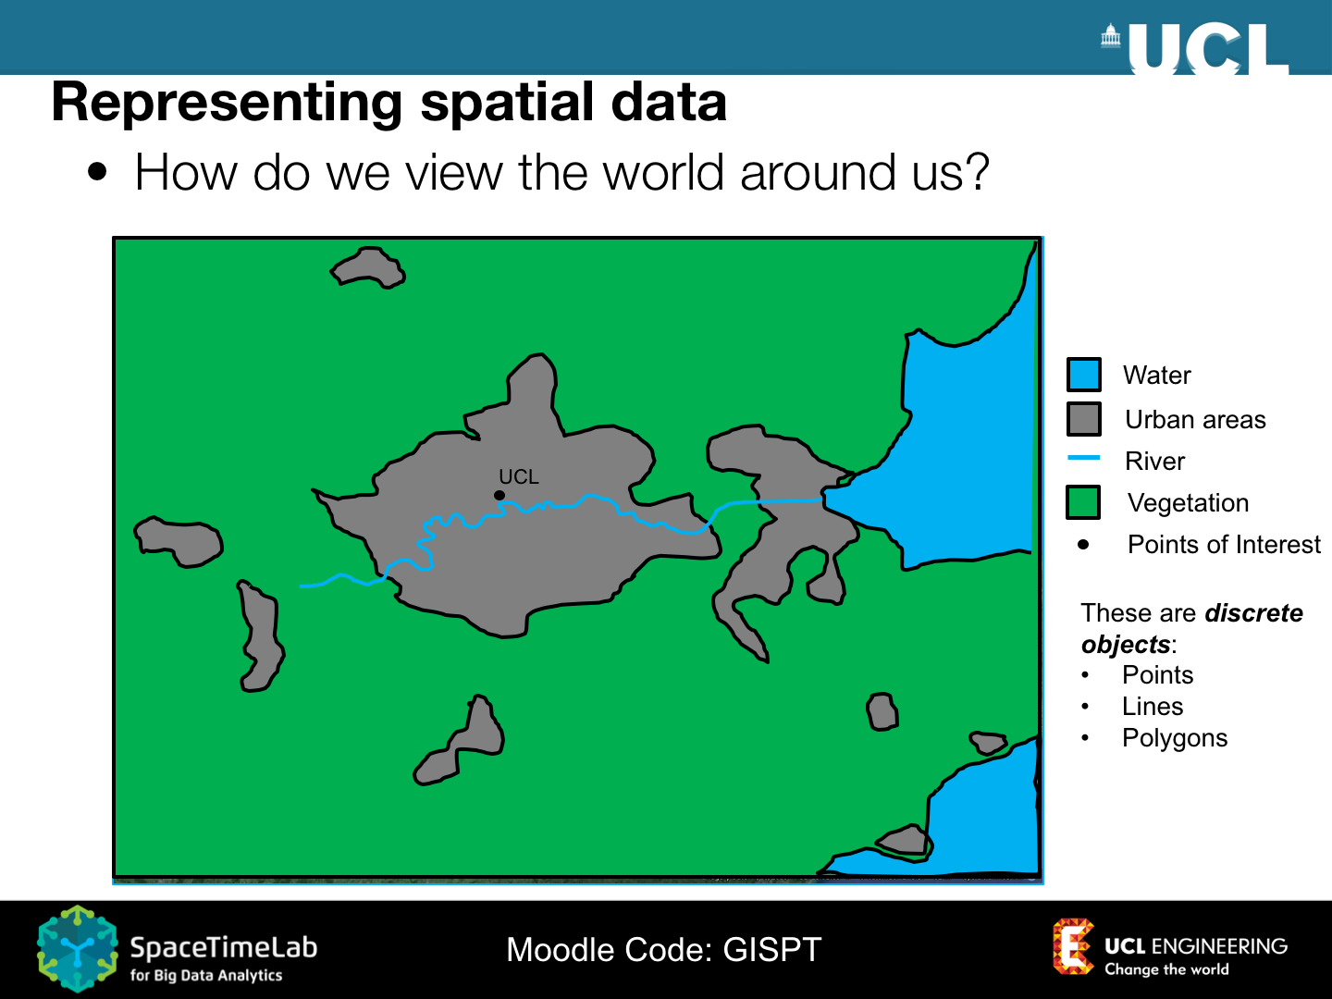
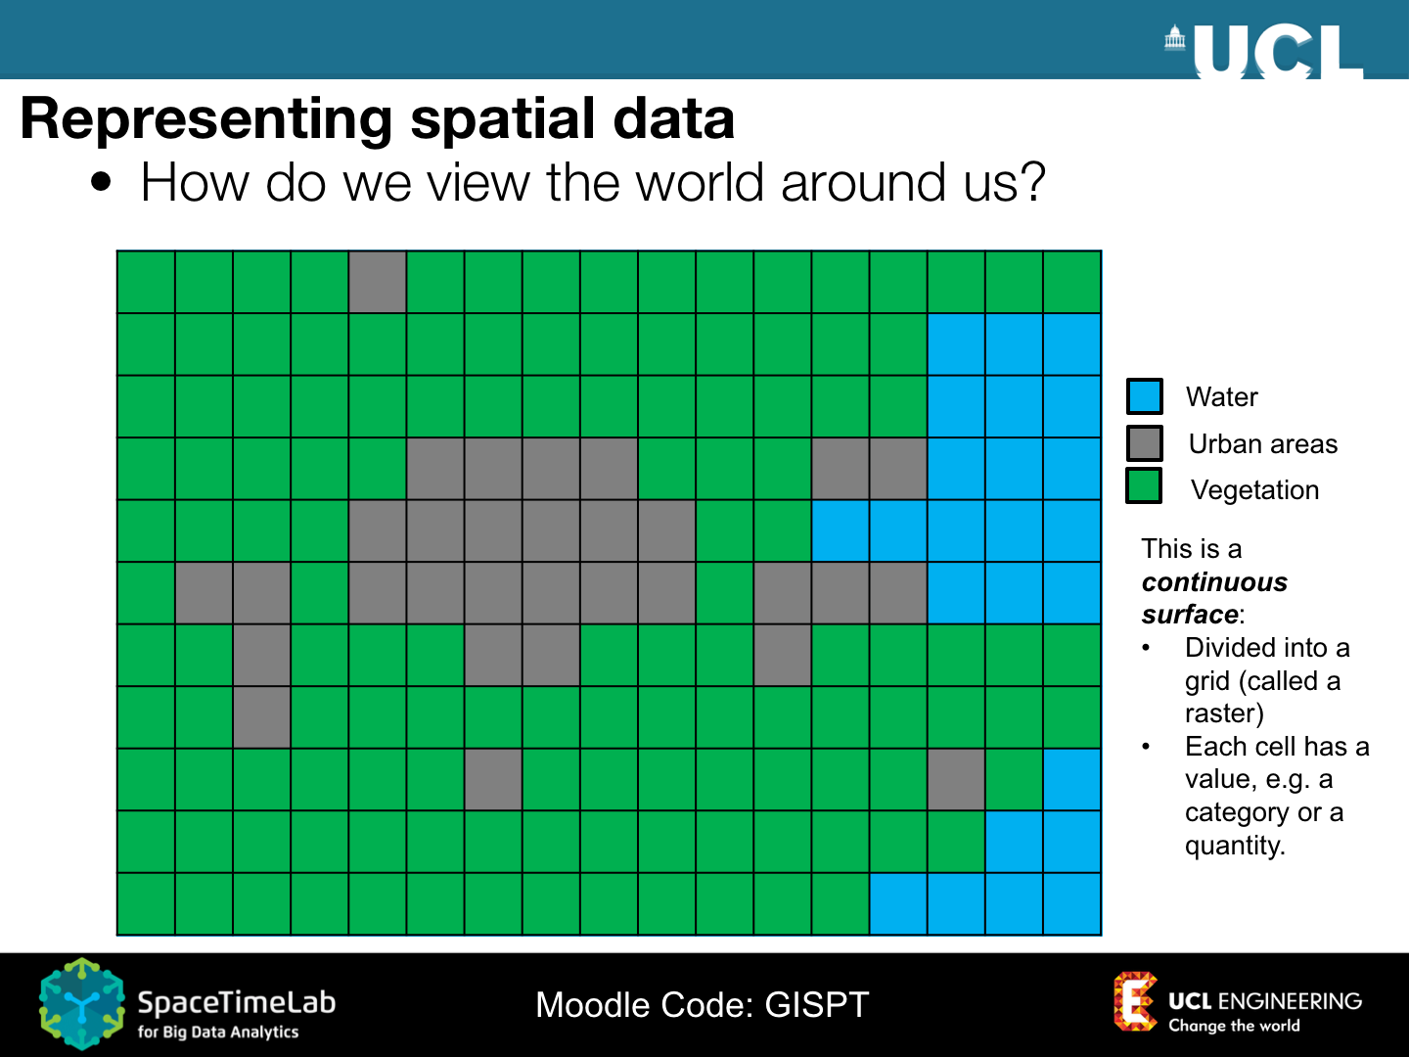
Raster Representation
Structured as an array or grid of cells, referred to as pixels (or grid cells).
The 3D equivalent is a 3D array of cubic cells, called voxels.
Each raster cell is addressed by its position in the array.
Each cell can store a number as an attribute.
Attributes can be binary, integer, or floating point.

Slide 22
Raster Representation (II)
Each cell in a raster will have a fixed dimension (the resolution).
The higher the resolution, the more detail can be represented in the raster at the expense of memory.
Rasters can be made on-the-fly using a mathematical function.
E.g. Inverse distance squared values from a point feature.

Slide 23
Questions
How would you implement the Vector representation in Python?
How would you implement the Raster representation in Python?

Slide 24
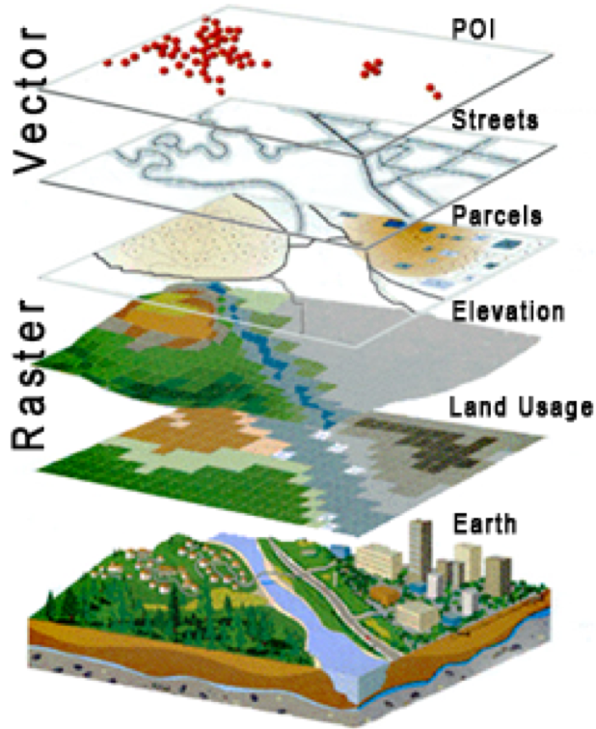
Layers (aka Levels)
Geospatial fields and features representing identical phenomena are collated together in layers.
In computer aided design, levels are used primarily for visualization.
Levels are less disciplined as different object types may exist together in the same level.
Layers can be combined with other layers for analysis and visualization.
A fully-capable GIS can combine data from different layers.

Slide 25
Physical Model
5
Transcribe the logical model into a data file.
Load the data file into a program.
The implemented physical model can be simulated, analyzed and visualized.

Slide 26
Exercise (Reflection on the Assignment)
Identify the modelling steps we took in the 1st Assignment to get from the Application Domain (the problem) to the Physical Model (the solution).
Application Domain
1
Application Domain Model
2
initial
study
Conceptual
Model
Computational Models
3
system
analysis
Logical Model
4
system
design
Physical
Model
system
implementation
5

Slide 27
Other Modelling Methods

Slide 28
Python Packages

Slide 30
NumPy
NumPy is an independent scientific computing package for Python.
Written in C for speed an efficiency. NumPy arrays (lists) occupy less memory and are faster than Python lists!
import numpy as np
The fundamental data structure of NumPy is the array:
arr = np.array([1, 2, 3, 4])

Slide 31
NumPy Arrays
Arrays can be 1D, 2D, 3D, or n-dimensional:
arr = np.array([[1, 2, 3, 4], [4, 3, 2, 1]])
Arrays can be created from any datatype. This is specified using the dtype keyword.
arr = np.array([1, 2, 3, 4], dtype=int)
You can also use C types:
arr = np.array([1, 2, 3, 4], dtype=np.int32)

Slide 32
Addressing Cells
The individual cells of an array can be addressed using [,].
For a 2D array we can address the the first element of the second row as:
arr = np.array([[1, 2, 3, 4], [4, 1, 2, 3]])
arr[1,0]

Slide 33
Stacking Arrays
Two arrays can be stacked together both vertically and horizontally.
Column-wise:
np.hstack([arr1, arr2])
Row wise:
np.vstack([arr1, arr2])

Slide 34
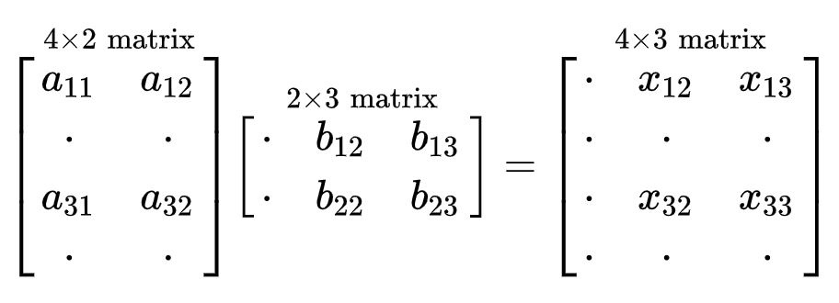
Arrays Operations
NumPy offers a new set of operations you can perform on arrays.
You can sum two arrays (+,-), compute the power exponentiation (**), conditions (==, <, >, <=, =<), and element-wise multiplication (*,/).
You can also perform matrix multiplications (@):

Slide 35
Documentation
http://numpy.org

Slide 36


Slide 37
Pandas
Pandas is a software library written for the Python for data manipulation and analysis.
import pandas as pd
It offers data structures and operations for manipulating numerical tables and time series.
These are called Series and DataFrames.
A Series is a column, and a DataFrame is a multi-dimensional table made up of a collection of Series.

Slide 38
Creating a DataFrame from Scratch
A way to create a DataFrame is from a python dictionary.
data = { 'x': [0, 1, 2, 3], 'y': [3, 2, 1, 0] }
Then, pass it to the pandas DataFrame constructor:
df = pd.DataFrame(data)

Slide 39
Creating a DataFrame from CSVs
With CSV files you can use read_csv:
df = pd.read_csv('points.csv')
To save a data frame as a CSV file:
df.write_csv('points.csv')

Slide 40
Check a DataFrame
To see the first n rows of a DataFrame:
df.head()
To see the last n rows of a DataFrame:
df.tail()
To get info about your DataFrame:
df.info()
To get stats:
df.describe()
To get the dimensions of your DataFrame:
df.shape

Slide 41
Accessing Columns
To know the column names of your DataFrame:
df.columns
To access a column:
df['x']
To access a column and return a DataFrame:
df[['x']]

Slide 42
Accessing Rows
To access the first row of a DataFrame:
df.iloc[0]
To access a single value of the first row:
df.iloc[0]['x']

Slide 43
Documentation
https://pandas.pydata.org/

